Slide 1



Deep Dive: Building AI agents using Amazon Bedrock
AWS GEN AI LOFT PARIS | OCTOBER 22, 2024
Viktoria Semaan
Tiffany Souterre
Senior Developer Advocate
AWS
Senior Developer Advocate
AWS

Slide 2








Human Workflow
Question: “We would like to add analytics to the SwissBox App. Provide implementation guidance”
Analyze requirements
Research
Knowledge Bases (Tech Docs, Customer Studies)
Response
(days later)
Results
Connect with Specialist teams
Customer
SwissBox
Tech Consultant
Build a prototype

Slide 3
AI Agent Workflow
Question: “We would like to add analytics to the SwissBox App. Provide implementation guidance.”
Q&A Chat with
Knowledge Bases
Query
Bedrock
AI Agent
Action 1 – Analyze requirements
Customer
SwissBox
Final response
(secs later)
Results
Tasks +
Results
Final Response
Action 2 – Generate IaC
Bedrock
model
Action 3 – Estimate Cost

Slide 4

AMAZON BEDROCK
Models to choose
Model Evaluation
INTRO Use Case

Slide 5




Amazon Bedrock Foundation Models
Broad choice of models
Contextual answers, summarization, paraphrasing
Text summarization, generation, Q&A, search, image generation
Summarization, complex reasoning, writing, coding
Text generation, search, classification
Q&A and reading comprehension
Text summarization, text classification, text completion, code generation, Q&A
High-quality images and art
Jamba-Instruct
Jurassic-2 Ultra
Jurassic-2 Mid
Titan Text G1 - Lite
Titan Text G1 - Express
Titan Image Generator G1 v2
Titan Text Embeddings V2
Titan Multimodal Embeddings V2
Titan Embeddings G1
Claude 3.5 Sonnet
Claude 3 Opus
Claude 3 Sonnet
Claude 3 Haiku
Claude
Claude Instant
Command
Command Light
Embed English
Embed Multilingual
Command R+
Command R
Llama 3.2 1B Instruct
Llama 3.2 3B Instruct
Llama 3.2 11B Vision Instruct
Llama 3.2 90B Vision Instruct
Llama 3.1 8B
Llama 3.1 70B
Llama 3.1 405B
Llama 3 8B
Llama 3 70B
Mistral Large 2 (24.07)
Mistral Small
Mistral Large
Mistral 7B
Mixtral 8x7B
SD3 Large 1.0
Stable Image Core 1.0
Stable Image Ultra 1.0
Stable Diffusion XL1.0

Slide 6
AMAZON BEDROCK
Models to choose
Model Evaluation
CUSTOMIZATION
Prompt Engineering
Knowledge Base (RAG)
INTRO Use Case

Slide 7




4 approaches to customize FMs
Foundation model
Preprompt + query
Query
Query
Query
I’m specialized for specific tasks
I’m more knowledgeable in a domain
My answers are influenced by the context
My answers are documented
Prompt engineering
RAG
Fine tuning
Continued pre-training
Cost, time, complexity

Slide 8




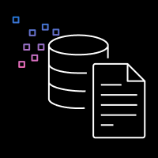
Knowledge Base: End-to-End RAG
User Input
4
8
9
10
Text Generation Workflow
User
Prompt augmentation
Large Language Model
Response
Embeddings model
Context
5
Embedding
7
0.89
-0.02
-0.53
0.95
0.17
-0.38
6
Data Ingestion Workflow
Semantic search
3
2
1
Vector store
Embeddings model
Document chunks
Data source

Slide 9
AGENT TOOLS
SA Q&A Generate IaC
Cost Estimation
AMAZON BEDROCK
Models to choose
Model Evaluation
CUSTOMIZATION
Prompt Engineering
Knowledge Base (RAG)
INTRO Use Case

Slide 10


AI Agent: Detailed Flow
PROMPT
Conversation history
Actions, Knowledge Bases Instructions Task
Step 1
Step 2
…
Step n
Search
Chain of thought
Results
Task:
Knowledge Bases
How to build analytics for the SwissBox app. How much it will cost to run it monthly?
Bedrock
Model
API call
Bedrock
Agent
Results
Results
Action Groups
Final response
Task + results
Decompose into steps using KBs and actions
Configuration steps:
1/…..
Expected cost: $178
Final response
Bedrock
model
Execute action or search knowledge base
Observe results
Think about next step

Slide 11
Tool 1: Question & Answer Bot
Tool 1: SA Q&A
How to…?
SwissBox information
Tool 2: Generate IaC
Solutions Architect Agent
Tool 3: Estimate Cost

Slide 12












Knowledge Bases
Data sources
Amazon S3
Web Crawler
Atlassian Confluence
Salesforce
Microsoft SharePoint
Titan Text Embeddings v2
By Amazon
Embed English v3
By Cohere
Embeddings
model
Titan Text Embeddings G1 – Text v1.2
By Amazon
Embed Multilingual v3
By Cohere
Vector database
Amazon
Aurora
Redis Enterprise Cloud
MongoDB Atlas
Pinecone
Vector Engine For Amazon OpenSearch Serverless

Slide 13

Tool 2: Generate IaC
Tool 1: SA Q&A
How to…?
SwissBox information
Tool 2: Generate IaC
Outline infrastructure
Solutions Architect Agent
Multimodal Language Model
Custom Code Repository

Slide 14
Tool 3: Estimate Cost
Tool 1: SA Q&A
How to…?
SwissBox information
Tool 2: Generate IaC
Outline infrastructure
Solutions Architect Agent
Multimodal Language Model
Custom Code Repository
Estimate cost
Tool 3: Estimate Cost
$
Cost Estimator

Slide 15





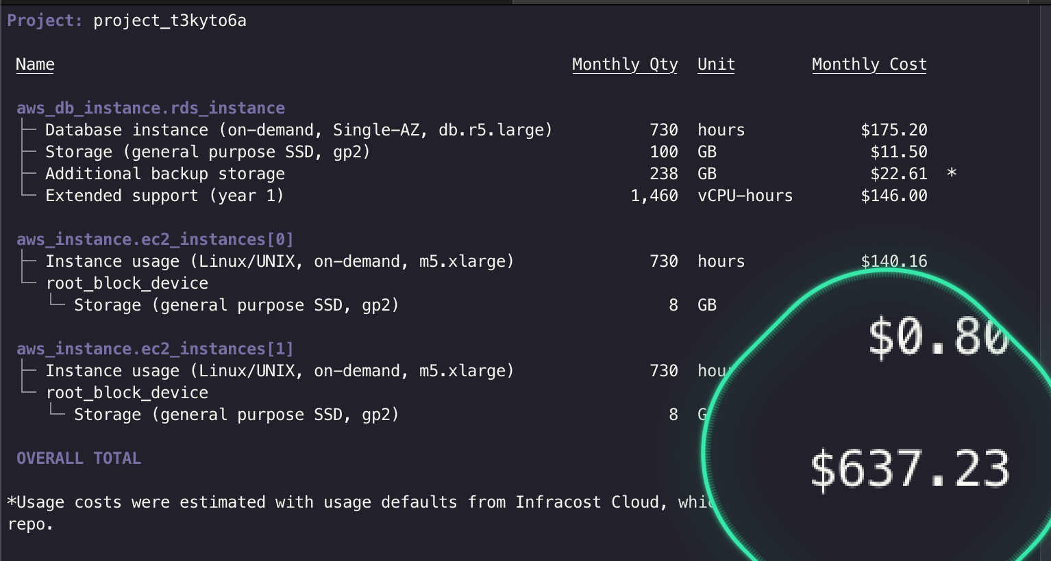
Cost Estimator: Configuration
resource "aws_db_instance" "db" {
allocated_storage = 100
instance_class = db.r5.large
...
}
resource "aws_instance" ”ec2" {
count = 2
instance_type = m5.xlarge
...
}
Amazon S3
IaC script
AWS Lambda
Compute
Database
Cost – $637

Slide 16
AGENT TOOLS
SA Q&A Generate IaC
Cost Estimation
ORCHESTRATION
Agents
AMAZON BEDROCK
Models to choose
Model Evaluation
CUSTOMIZATION
Prompt Engineering
Knowledge Base (RAG)
INTRO Use Case

Slide 17




Orchestration with agents
Action groups
API schema (.json)
{
/answer_query #tool 1
{description: …}
/iac_gen #tool 2
{description: …}
/iac_estimation_tool #tool3
{description: …}
}
/answer_query
/iac_estimation_tool
/iac_gen

Slide 18
LIVE DEMO TIME!

Slide 19
AGENT TOOLS
SA Q&A Generate IaC
Cost Estimation
WRAP-UP
Takeaways
Resources
ORCHESTRATION
Agents
AMAZON BEDROCK
Models to choose
Model Evaluation
CUSTOMIZATION
Prompt Engineering
Knowledge Base (RAG)
INTRO Use Case

Slide 20

3 Key Takeaways
Evaluate different models on cost, speed, and efficiency using Amazon Bedrock’s single-API access.
Customize your model with one or a combination of prompt engineering, RAG, fine-tuning or continued-pretraining.
Give hands to your model with agents so they are able to perform actions through API schemas, descriptions and lambda functions.

Slide 21



Additional resources
GitHub repo: Building AI Assitants with Amazon Bedrock Agents
This repository contains instructions and code samples to help customers build AI agents using Amazon Bedrock. It includes three tools: Solutions Architect Q&A, Terraform script generation, and cost estimation using InfraCost.
GitHub repo: Amazon Bedrock samples
This repository contains pre-built examples to help customers get started with the Amazon Bedrock service including: Knowledge Bases, RAG, Agents, Bedrock Fine-tuning, Security and Governance
PartyRock app: Generative AI Agents For Amazon Bedrock
This prototype app lets you describe an API, and generate code for Agents for Amazon Bedrock. The generated code includes: an OpenAPI schema providing a rich description of the API, Python Lambda function implementation based on the generated API schema, test suite for the API, delivered as a json array of Lambda event payloads based on the generated API schema.

Slide 22


Thank you !
Viktoria Semaan
Tiffany Souterre
linkedin.com/in/semaan
linkedin.com/in/tiffanysouterre

